Slide 1


DESIGN REVIEW 4
SAE Aero
Team
Team 508:
David Jay Michael Nalovic Sofia Rodriguez Tristan Wahl

Slide 2
DESIGN REVIEW 4
SAE Aero
Team
Team 508:
David Jay Michael Nalovic Sofia Rodriguez Tristan Wahl

Slide 3

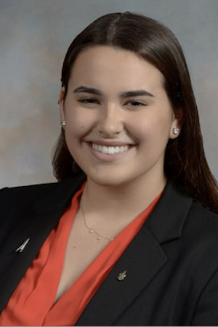
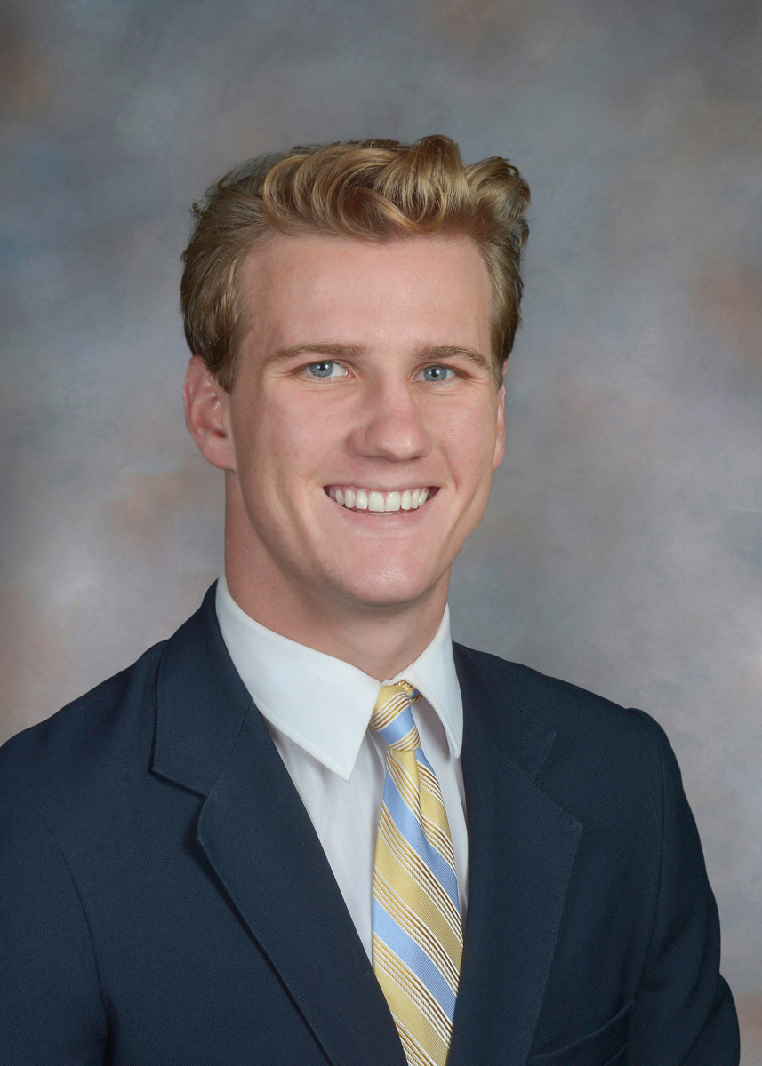
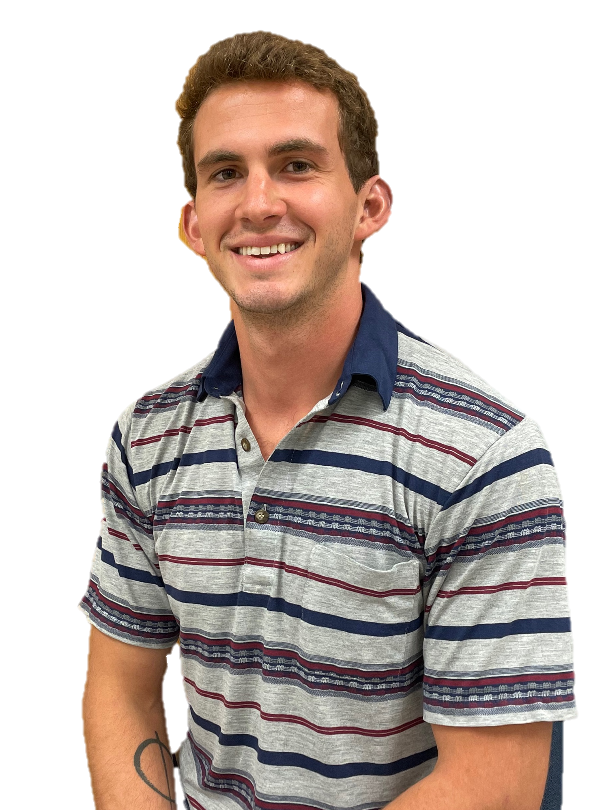
Meet Team 508
David Jay
Manufacturing Engineer
Michael Nalovic
Controls Engineer
Sofia Rodriguez
Aeronautics Engineer
Tristan Wahl
Flight Design Engineer
Michael Nalovic

Slide 4



Sponsors and Advisor
Florida Space Grant Consortium
Dr. Yousuf Ali
Teaching Faculty II
Seminole RC Club
Michael Nalovic
Notes:
FSGC – Volunteer organization that assists with aerospace research funding in the state of Florida
Dr. Ali – Professor here at the FAMU-FSU COE with a primary focus in thermal fluids. He will be assisting us with the engineering analysis of our designs
Seminole RC – a local RC club that is providing our group with materials and practical knowledge of RC planes

Slide 5
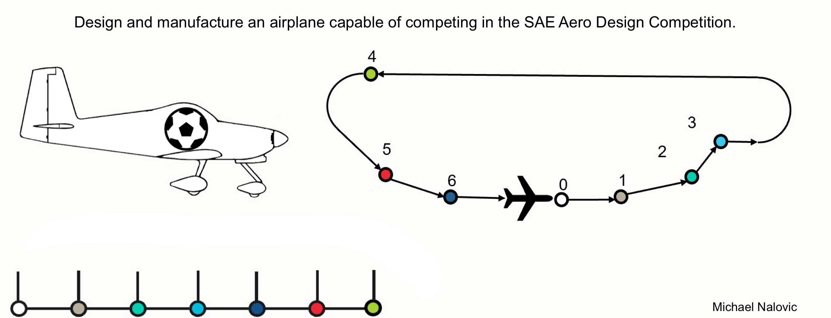
Project Objective
Load
Takeoff
Ascend
Turn
Reorient
Land
Unload
Notes:
Talk to 507 about mission profile
Take the lines out w procreate

Slide 6






Key Goals
Adhere to Competition Guidelines
Design Wing and Tail Section
Aerodynamic Analysis
Manufacture and Test
Michael Nalovic
Notes:
The first key goal that our team defined is to adhere to the SAE competition guidelines. These guidelines dictate the mission profile, material restrictions, and general design requirements.
Our group will be specifically focusing on the aerodynamics of the airplane, so our next goal is to design the wing and tail section.
Next, we will need to perform an aerodynamic analysis of the plane.
Finally, we will need to manufacture and test our wing/tail sections.

Slide 7
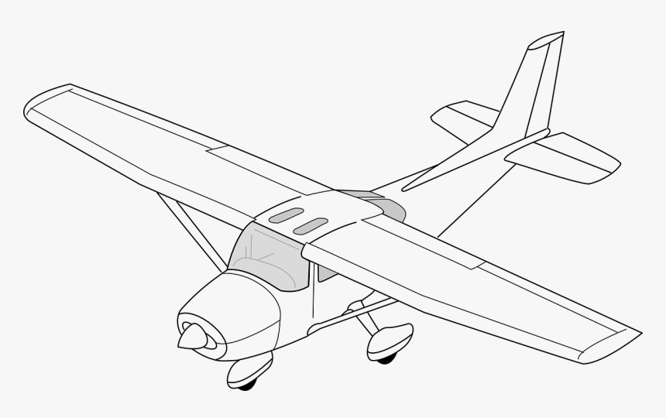
Airplane Controls Explained
1
Ailerons – Control Roll
2
Elevator – Controls Pitch
3
Throttle – Controls Motor Thrust
4
Rudder – Controls Yaw
5
Flaps – Increase Lift and Drag
Michael Nalovic
Notes:
Change this
RC aircraft generally have at least the first 4, HOWEVER, some configurations can get away with only 3.

Slide 8
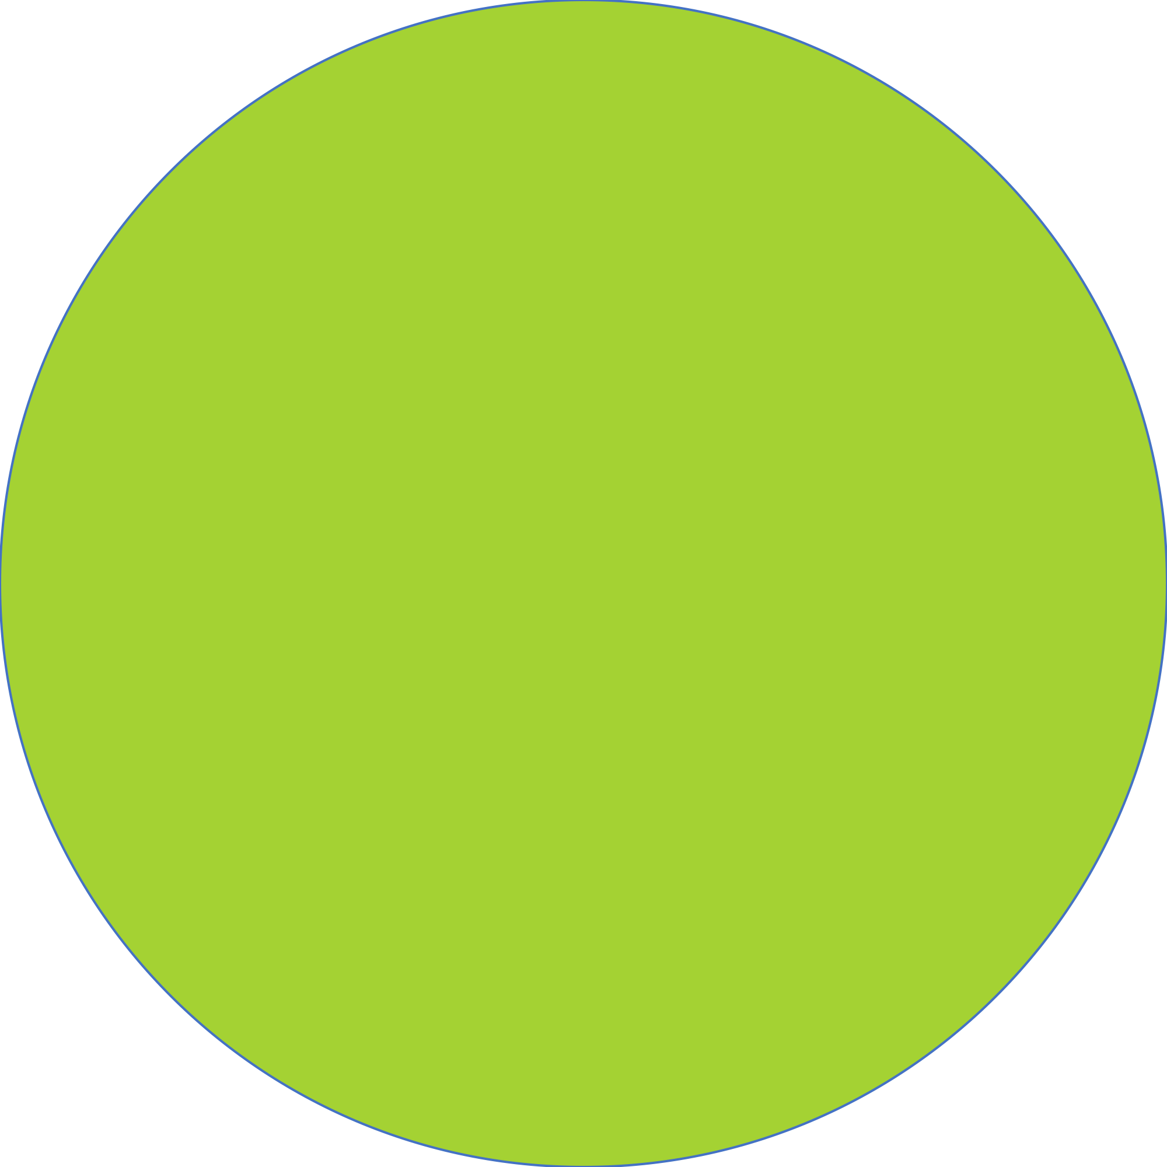









Major Functions
Takeoff
Landing
Carry Payload
Flight Controls
Michael Nalovic
Notes:
Animate this to go in a specific order
And correct the alignment

Slide 9
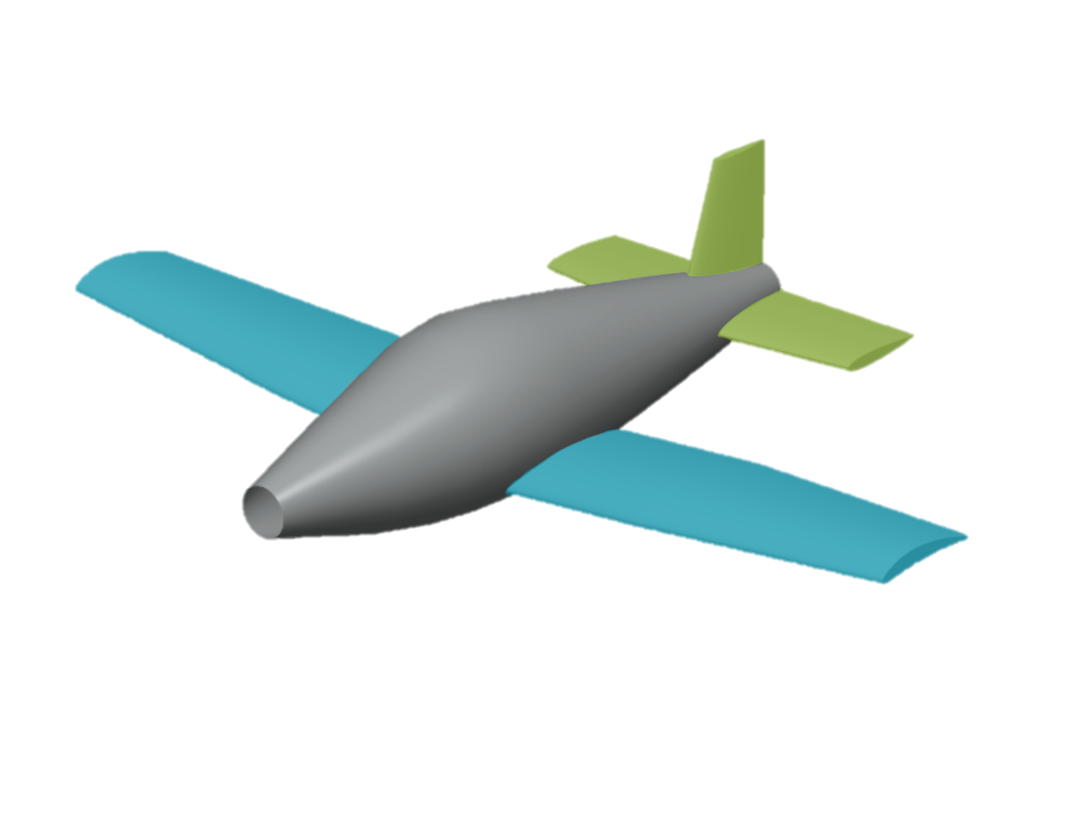
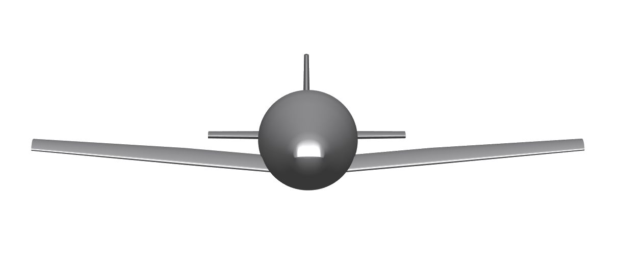
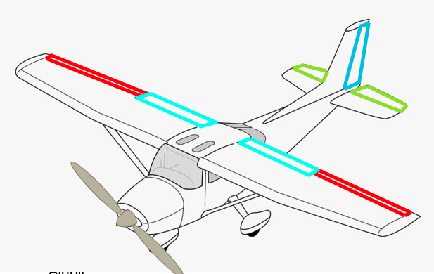
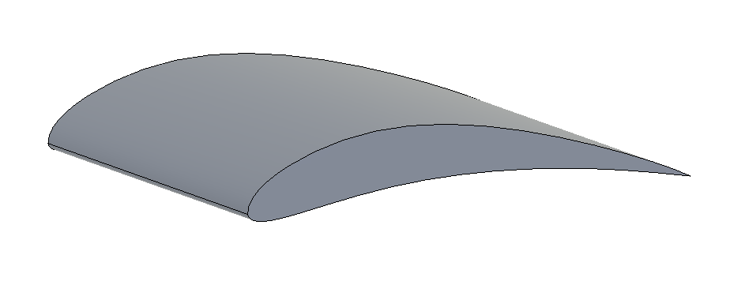
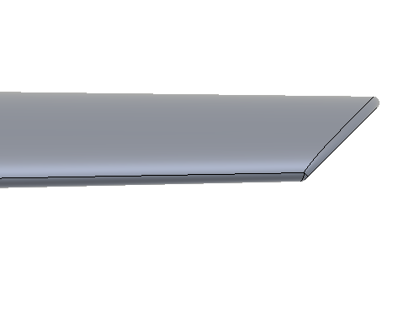
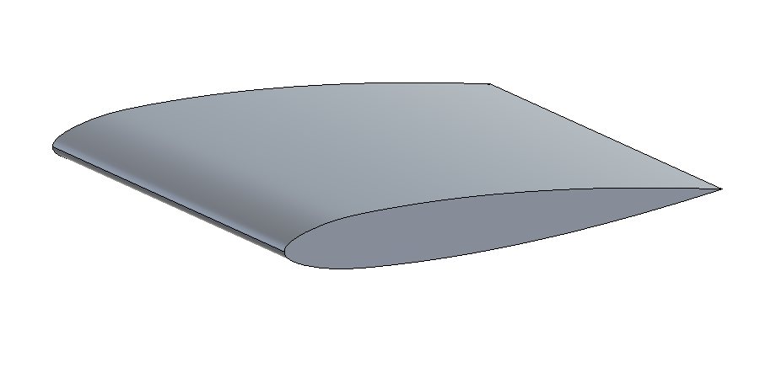
Previous Work
Dihedral 5°
Conventional Tail
Low Wing
Controls Sizing
Eppler 423
Main Airfoil
Hoerner Wing Tips
NACA 0012
Tail Airfoil
Michael Nalovic
Notes:
Change all this
Too much info, explain airfoil and wing tips better
Take off corner right

Slide 10
Timeline
Start Wing Printing
Begin Tail Printing
Final
Assembly
Jan
Feb
March
April
Finalize
Wing
Design and Integration
Test
Wing
Attachment
Finish
Wing Prints
Tail
Attachment
Wiring
Testing
Michael Nalovic
Notes:
Spring project plan w edits in a graphic
Sof
Add VDR 5 as a stop
Finalize tail
Start printing tail
Tail-fuselage connection
Filament dryer

Slide 11

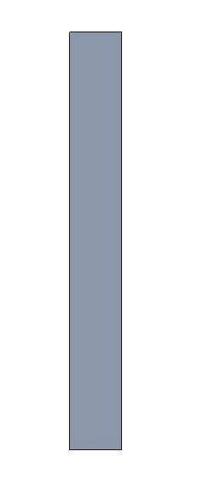
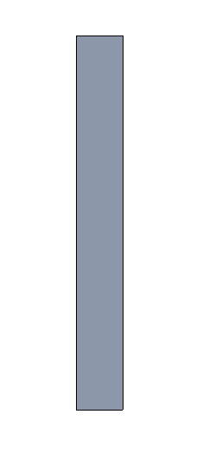
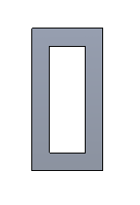
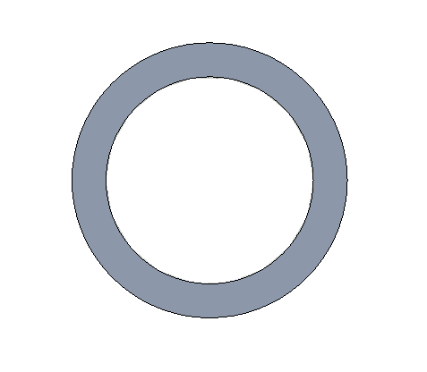
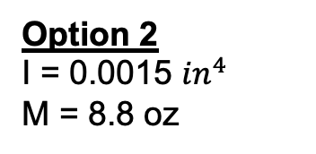


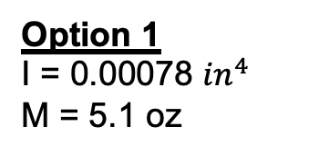





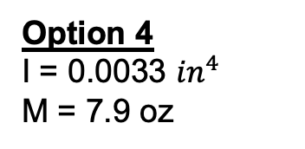

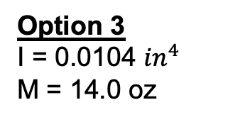

Spar Selection
$$\frac{3}{8}in$$
$$1 in$$
$$\frac{3}{4}in$$
$$\frac{1}{16}in$$
$$\frac{1}{2}in$$
$$\frac{1}{16}in$$
$$\frac{1}{4}in$$
$$\frac{1}{8}in$$
$$\frac{3}{32}in$$
Option 1
I = 0.00078 ${in}^{4}$
M = 5.1 oz
Option 2
I = 0.0015 ${in}^{4}$
M = 8.8 oz
Option 3
I = 0.0104 ${in}^{4}$
M = 14.0 oz
Option 4
I = 0.0033 ${in}^{4}$
M = 7.9 oz
I: Area moment of inertia
M: Mass of a 6 ft aluminum spar
David Jay
Notes:
Explain why we made these decisions
From where
Why

Slide 12
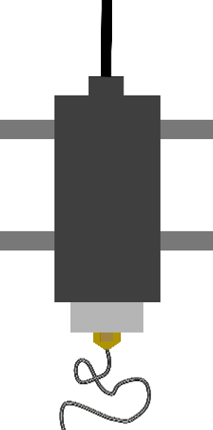
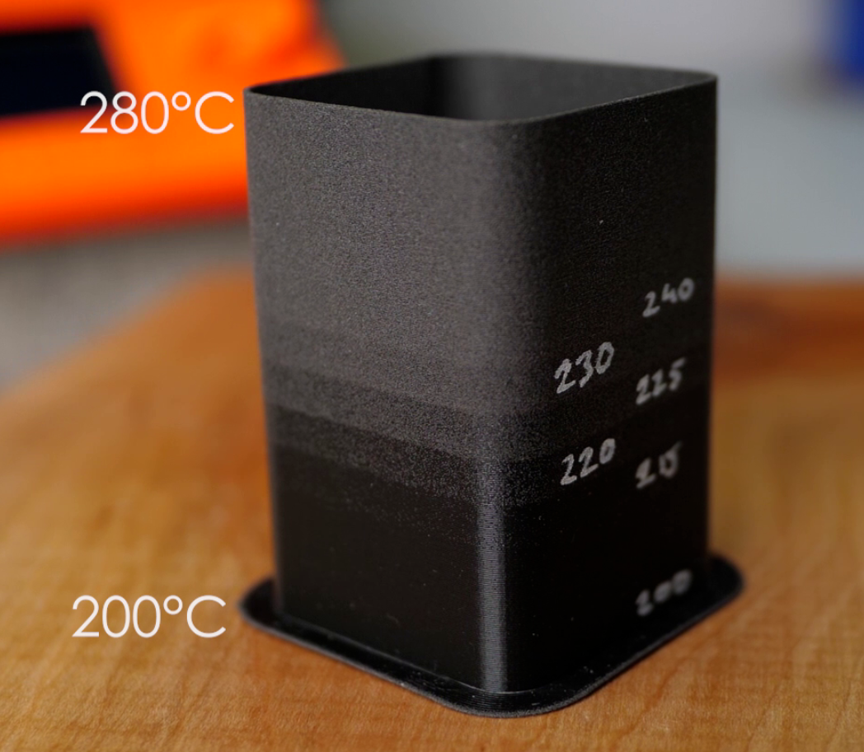

Material Selection - LWPLA
Initial Density
Flow rate
Temperature
Final Density
David Jay

Slide 13
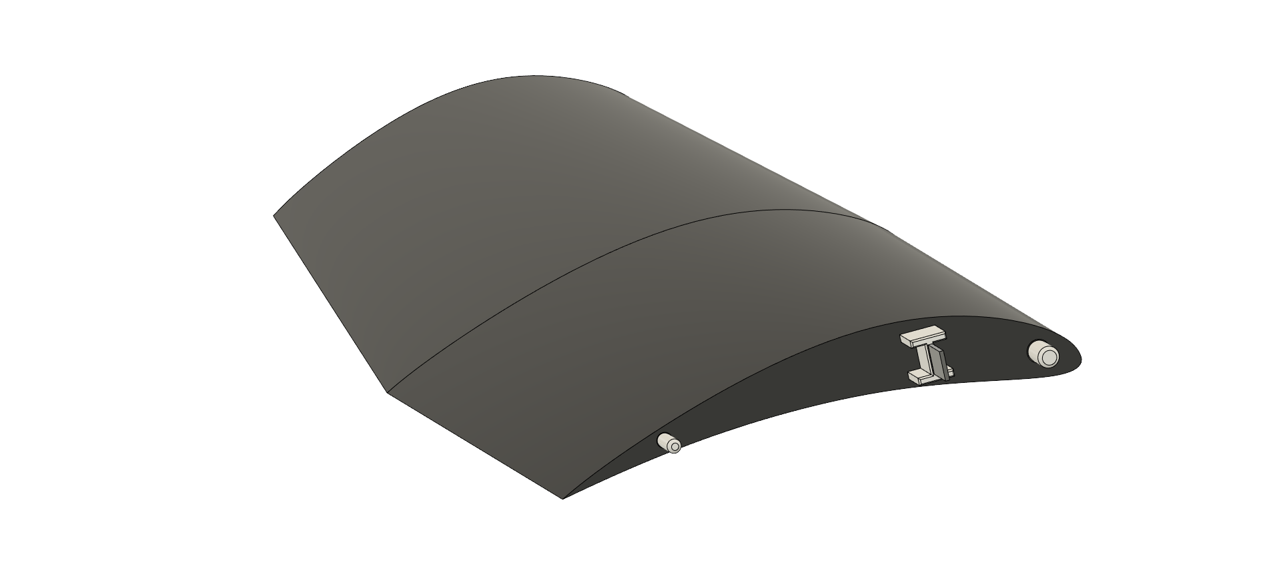


Tolerance Testing
0.2 - 0.6 mm
David Jay

Slide 14
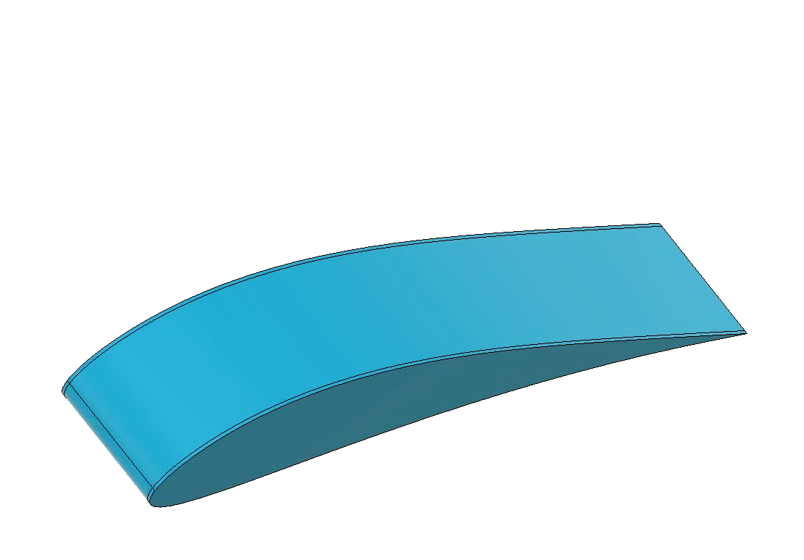
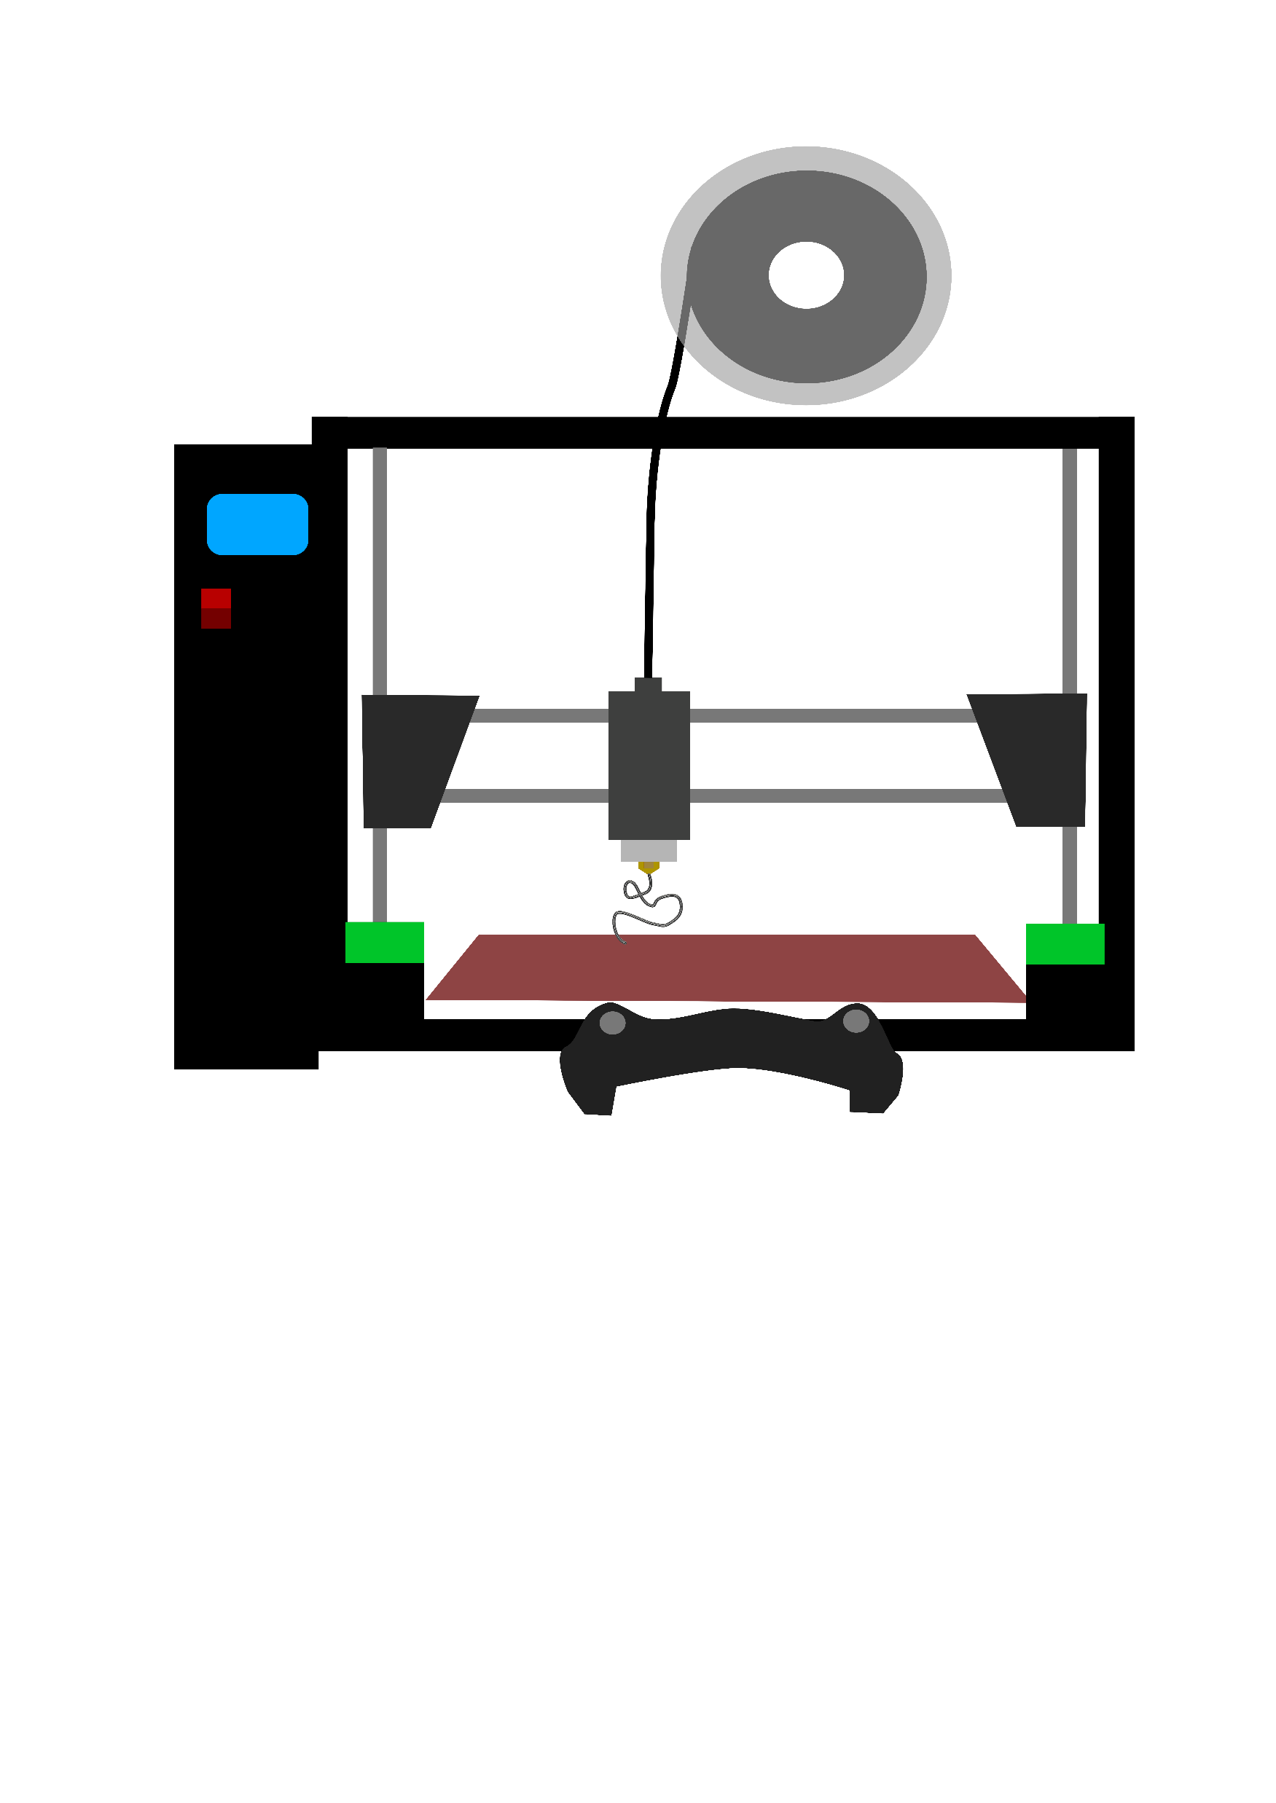






Weight Estimation
$${\text{ρ}}_{Initial}=2.1\frac{g}{{cm}^{3}}$$
$${\text{ρ}}_{Shell}=flowrate∗{\text{ρ}}_{Initial}$$
$${\text{V}}_{Shell}=SA∗thickness$$
$${\text{ρ}}_{infill}=infill\%∗{\text{ρ}}_{Shell}$$
$$V_{infill}=V−V_{shell}$$
David Jay

Slide 15
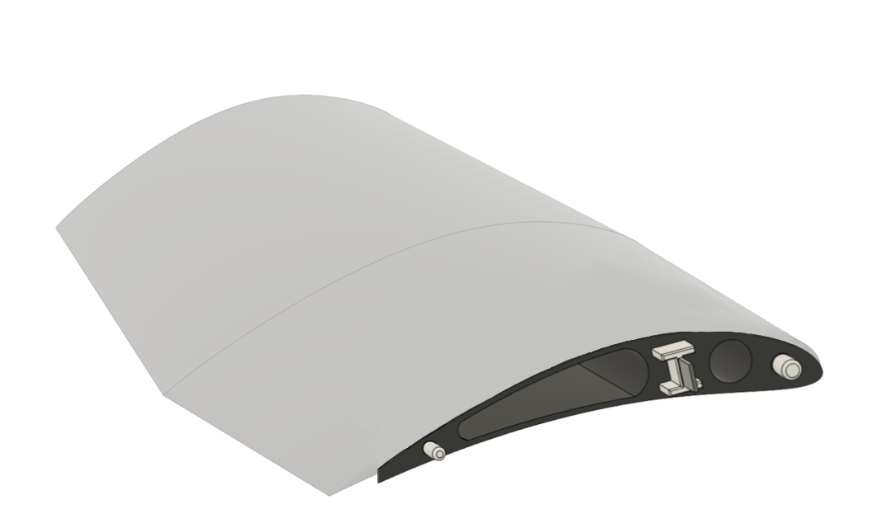
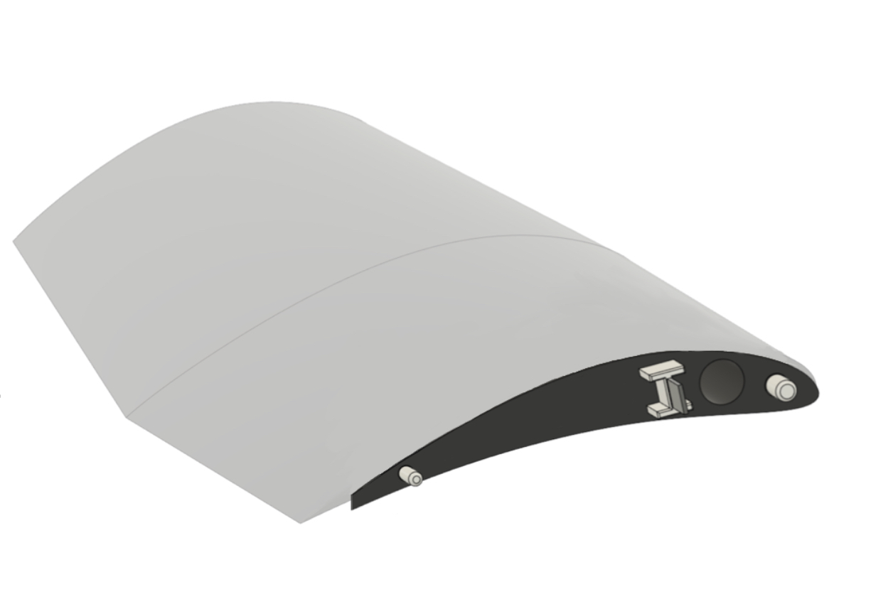

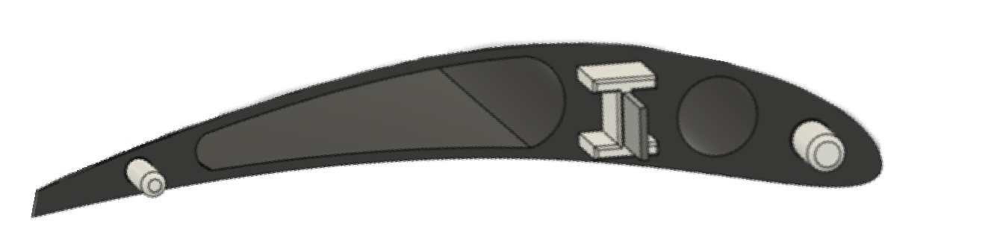
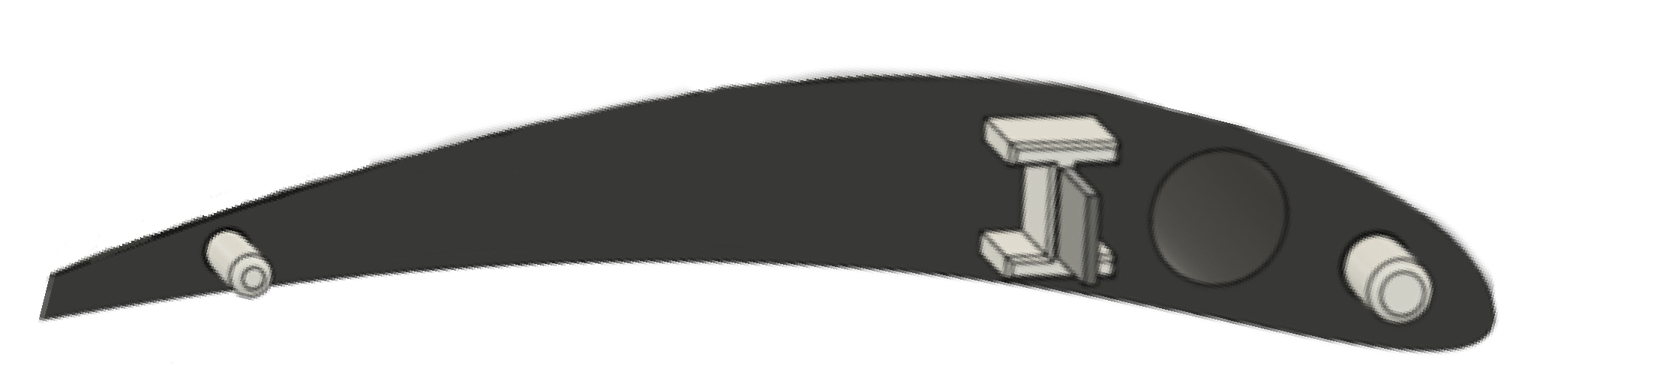
Light Weighting
David Jay
Notes:
Grow left one to emphasize cross section and do the same with the right one
4 step animation

Slide 16
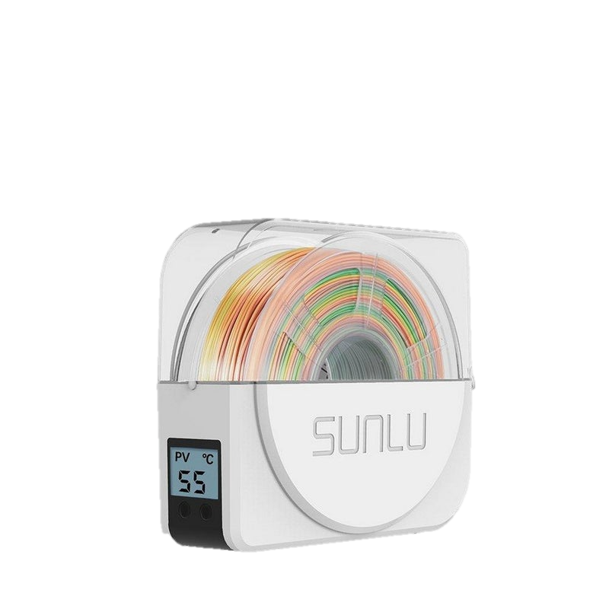
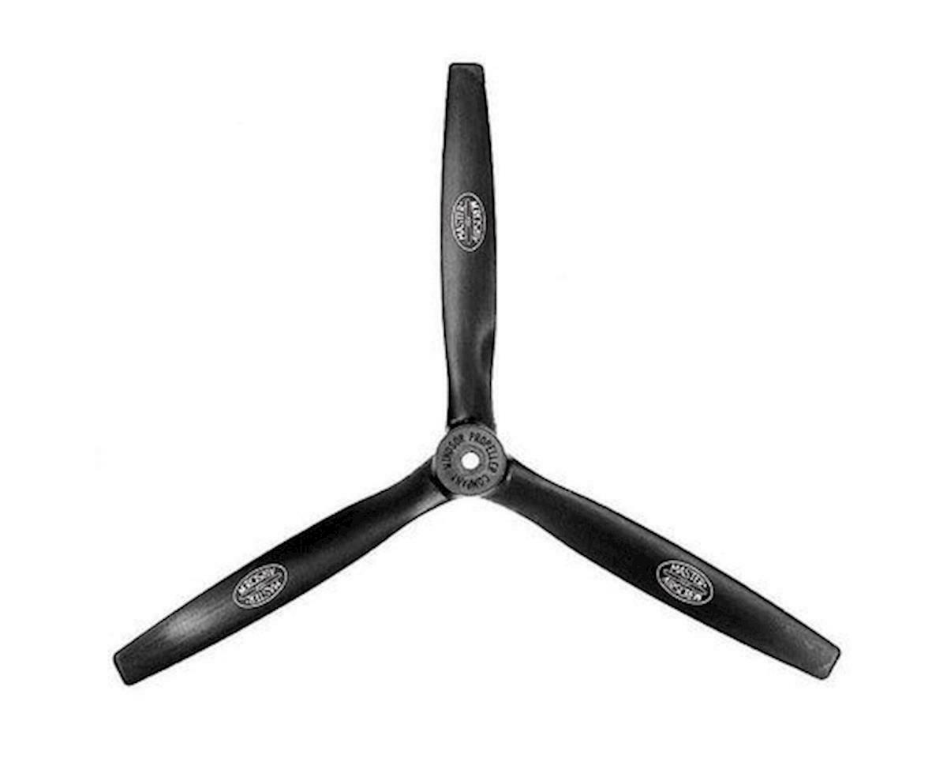
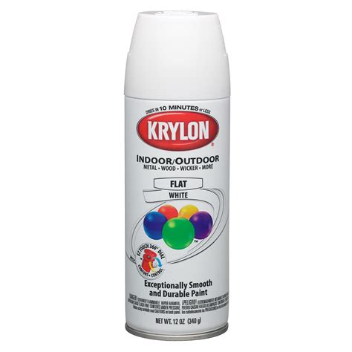

Bill of Materials
16x10 3 Blade Propeller
Filament Dryer
2 USB Webcams
White Spray Paint
David Jay
Notes:
Change the spray can
Blade propeller

Slide 17
References
Dr. McConomy, S. (2021). Customer Needs.
“2022 SAE Aero Design Rules.” SAE Aero Design, www.saeaerodesign.com/cdsweb/gen/DocumentResources.aspx.
Raymer, D. P. (1992). Aircraft design: A conceptual approach.
https://www.cnckitchen.com/blog/colorfabb-lw-pla-testing-foaming-pla (CITE ME)
David Jay

Slide 18


TEAM 508 COLORS
Accent1
647 C
Color Values:
RGB 35 97 146
Hex/HTML #236192
CMYK 96 54 5 27
Accent4
2239 C
Color Values:
RGB 0 207 180
Hex/HTML #00CFB4
CMYK 59 0 39 0
Light 1
White
Color Values:
RGB 255 255 255
Hex/HTML #FFFFFF
CMYK 0 0 0 0
Dark 1
100% Black
Color Values:
RGB 0 0 0
Hex/HTML #000000
CMYK 0 0 0 100
Pantone
647 C
Pantone
2239 C
White
Black
Accent 2
2199 C
Color Values:
RGB 0 187 220
Hex/HTML #00BBDC
CMYK 77 0 16 0
Accent5
7535 C
Color Values:
RGB 183 176 156
Hex/HTML #B7B09C
CMYK 10 11 23 19
Light 2
25% Black
Color Values:
RGB 191 191 191
Hex/HTML #bfbfbf
CMYK 0 0 0 25
Dark 2
75 % Black
Color Values:
RGB 64 64 64
Hex/HTML #404040
CMYK 0 0 0 75
Pantone
2199 C
Pantone
7535 C
CoE Lt Gray
CoE Dk Gray
Accent3
1788 C
Color Values:
RGB 238 39 55
Hex/HTML #EE2737
CMYK 0 88 82 0
Accent6
2299 C
Color Values:
RGB 164 210 51
Hex/HTML #A4D233
CMYK 41 0 84 0
Pantone
1788 C
Pantone
2299 C
Notes:
These are the college colors as prioritized within this PowerPoint Template

Slide 19



Customer Needs
01
02
03
AHERE TO SAE
GUIDELINES
3D PRINTED
PLANE
INNOVATION
Follow SAE competition rules and restrictions
Create a new and different design
Majority of the plane must be made of 3D printed material
Michael Nalovic
Notes:
Our primary customer for this project is our Senior Design Professor, Dr. McConomy. He gave us 3 primary needs:
-of course we need to comply with SAE competition guidelines
-We need to be innovative in some way or another. Incorporating new ideas wherever possible
-Finally, Dr. McConomy has specified that our plane must be 3D printed. This means that the majority of structural components must be 3D printed.

Slide 20
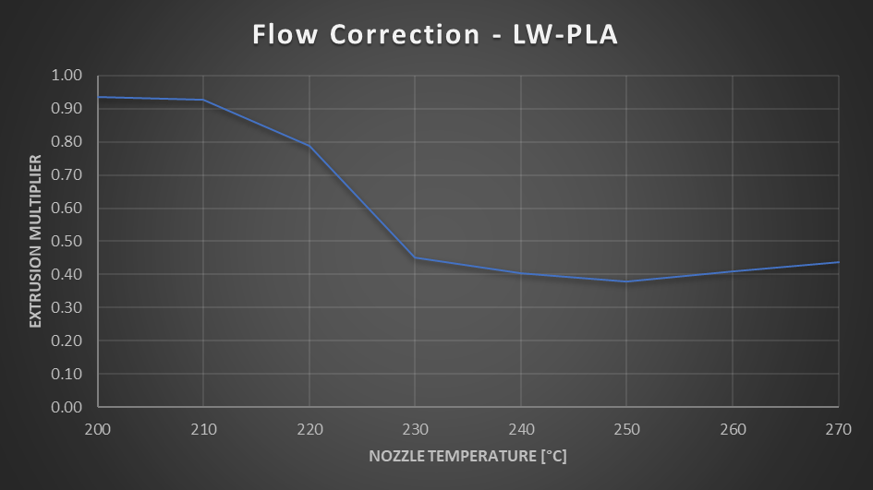
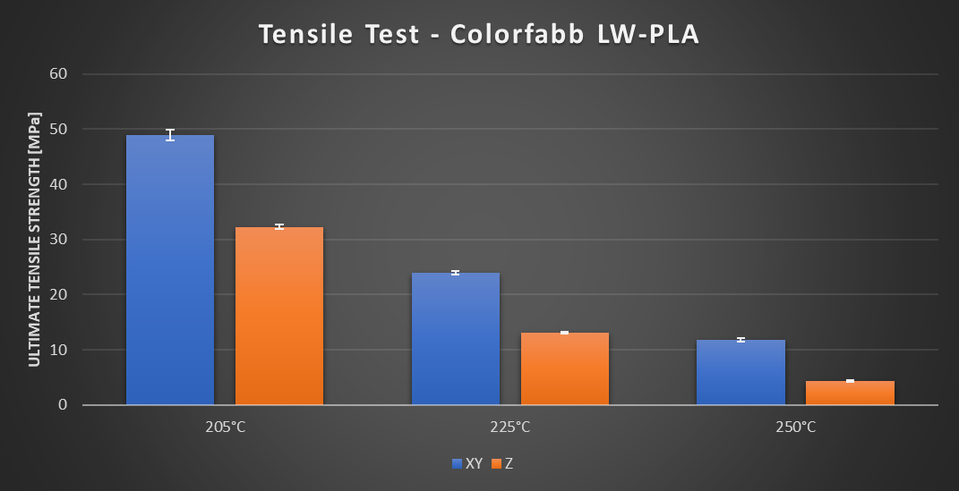
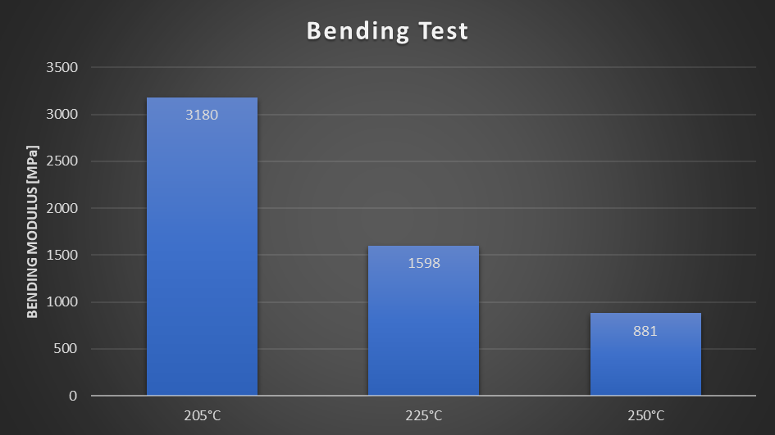
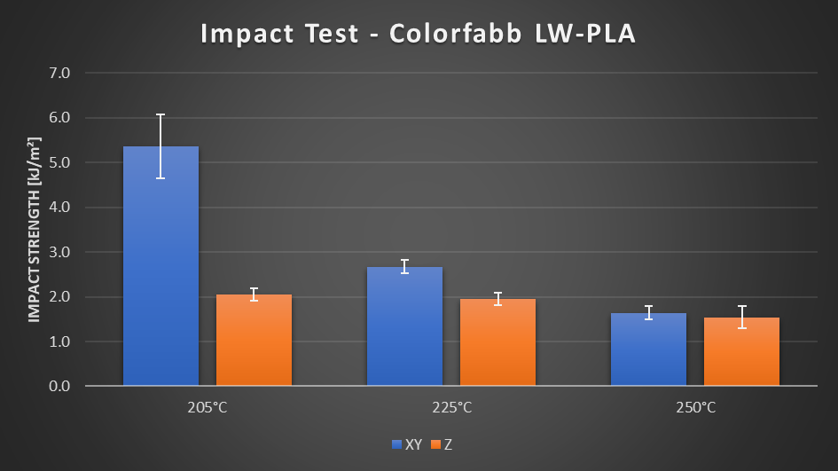
LWPLA more info
Notes:
CNC kitchen data

Slide 21
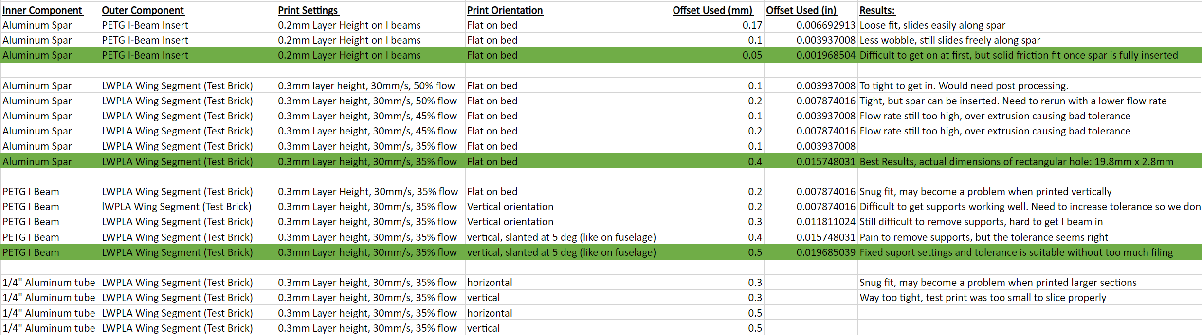
Tolerance Testing Data

Slide 22
More control integeration on fuselage

Slide 23
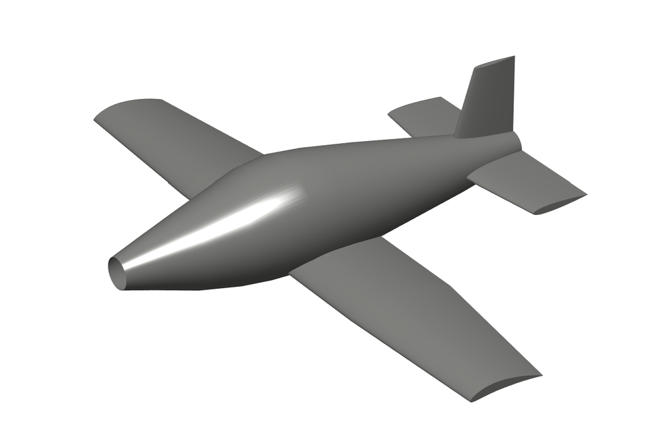
Final Concept
"Whale" Fuselage design
Eppler 423 Airfoil
Low Wing
Tail Dragger Landing Gear
Conventional Tail
Hoerner Wing Tips
David Jay
Notes:
Although our concept selection process deemed the SR-22 best for our project, this design lacked in the major aspect of innovation. For the "Final" concept our team will be moving forward with, we decided to use the general layout of the SR-22 design with a new, more innovative fuselage that is better suited for our application.

Slide 24

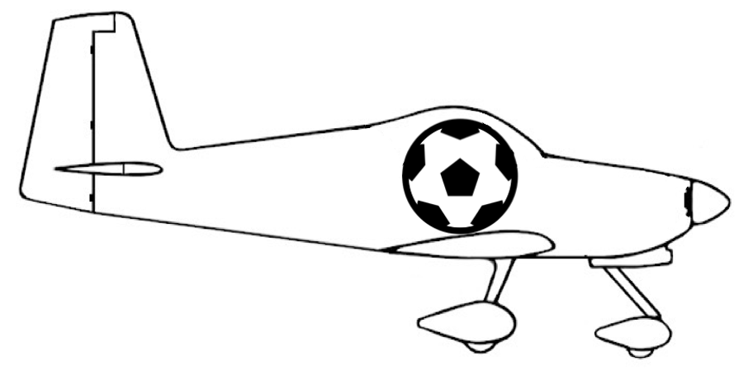
Project Objective
Design and manufacture an airplane capable of competing in the SAE Aero Design Competition.
Our team will be concerned with
    Manufacturing/Testing wings and tail
    Aerodynamics of the airplane
Michael Nalovic
Notes:
Deleted: Aircraft must be capable of carrying a size 5 soccer ball and taking off within 100ft
Take the lines out w procreate

Slide 25
Mission Profile
0. Mission starts with payload on board
1. Takeoff in less than 100ft
2. Ascend to safe cruise altitude
3. After traveling 400ft, turn back toward runway
4.Reorient for landing approach
5. Land on the same runway
6. Unload payload in under 1 minute
Michael Nalovic
Notes:
This is the mission profile as interpreted from the SAE guidelines

Slide 26



Targets and Metrics
Takeoff
Flight Control
Metric
Metric
Metric
Takeoff Distance
Thrust Force
Wing Area
Metric
Metric
Metric
Control Surface Deflection
Rise Time of Motor Speed
Static Margin
Less than 100ft
Greater than 10lbs
Greater than 6 ft
At least 25°
4 seconds
5%– 15%
Target
Target
Target
Target
Target
Target
2
Michael Nalovic
Notes:
Our team allowed the fuselage group to determine their own targets and metrics for the payload and landing gear, while we focused more on takeoff and controlling the plane. Here we have displayed some of the most important metrics that contribute to the aerodynamic success of the airplane.
Our takeoff distance was predefined by the competition guidelines. Using this metric, we made some initial estimates to calculated a required thrust force for the plane based on a wing with a 6ft^2 planform area. The only reason a minimum planform area is defined as a metric is because our calculations all began with that minimum assumption.
For control, the first metric we placed was a minimum control surface deflection. Typically control surfaces lose effectiveness past 20deg, so we design for a larger deflection that can be turned down on the transmitter. In addition, we also require that the motor selected has a minimum rise time of 4 seconds. This will ensure that the pilot has ample throttle control to get out of potentially dangerous situations. Finally, we have set a target for the static margin of the airplane. The static margin is an indicator of the airplanes pitch stability and should be between 5% and 15%

Slide 27
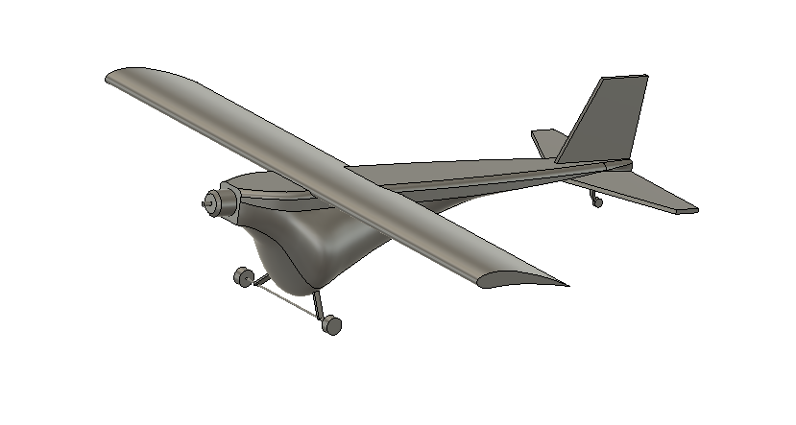
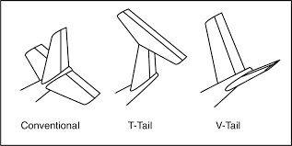

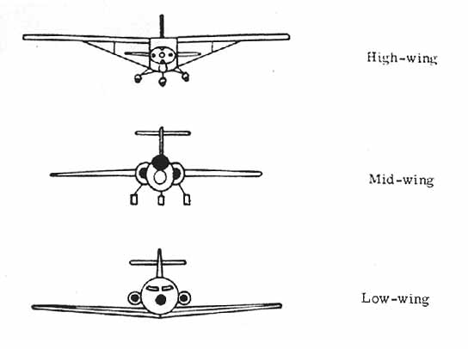
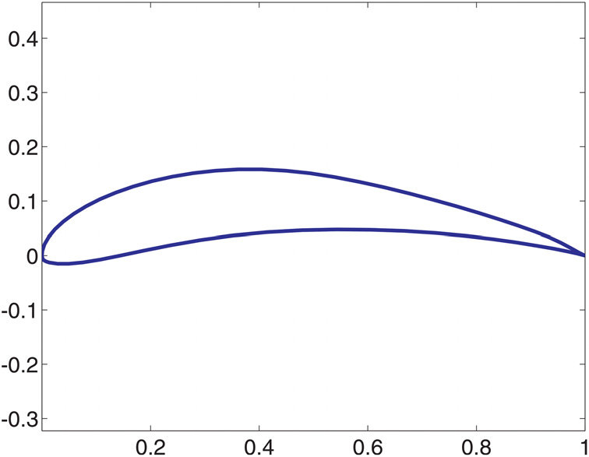

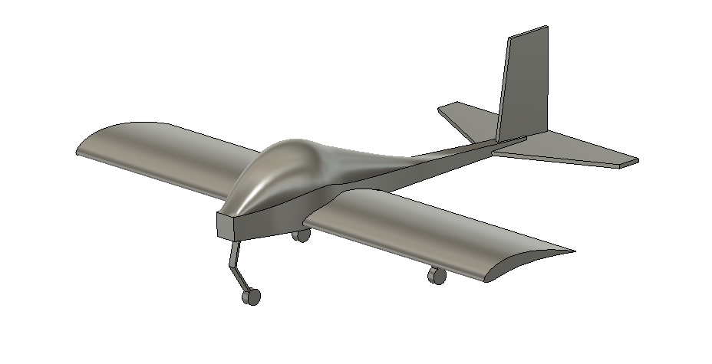
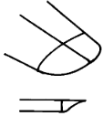
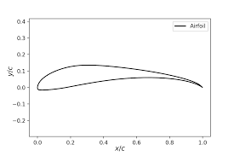
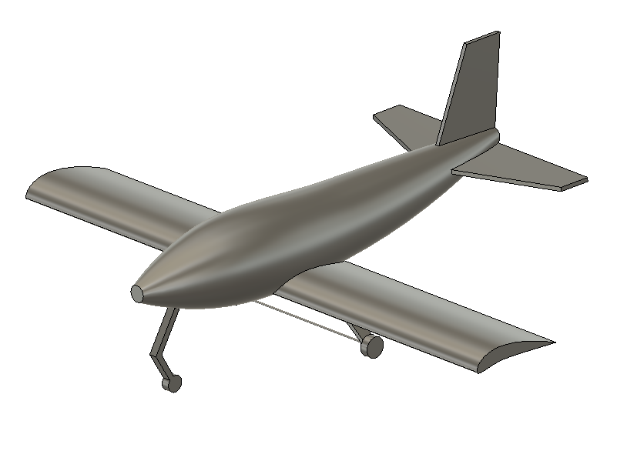
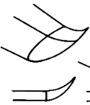
Concept Generation
Fuselage Type
Airfoil
Wing Placement
Landing Gear
Tail
Wing Tips
"Guppy"
High Wing
Standard
Cutoff
E-423
Tricycle
"Dolphin"
Mid Wing
T-Tail
Hoerner
S-1223
Tail Dragger
Low Wing
V-Tail
Upswept
"Whale"
Tristan Wahl
Notes:
In order to come up with multiple concept ideas, we started with a morphological chart with our initial design ideas.
We decided the 3 fuselage concepts from our prototypes, the airfoils from their data and earlier research, the wing placements and their various tradeoffs, the 2 landing gear setups, types of tails and eventually wingtips to help with our innovation requirement
http://www.zenithair.com/stolch801/design/design.html

Slide 28
High Fidelity Concepts
Guppy
Dolphin
Whale
Tristan Wahl

Slide 29
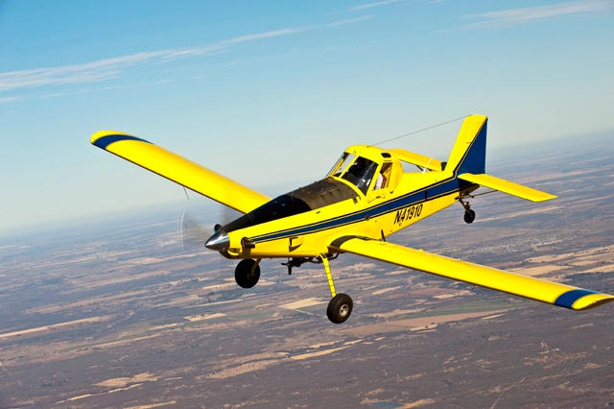
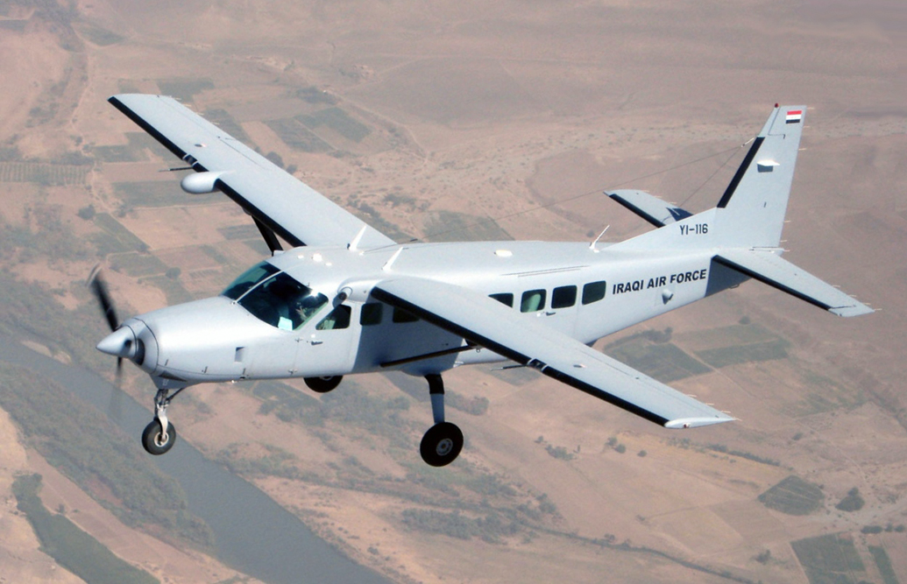


Medium Fidelity Concepts
Concept 1
  Air Tractor AT-502B
Concept 2
  Cessna 208B
Concept 3
  Cirrus SR-22
Concept 4
  Vans Aircraft RV-14
Fig.1 Air Tractor
Fig. 2 Cessna 208B
Fig. 3 Cirrus SR-22
Fig. 4 Vans Aircraft RV-14
Tristan Wahl
Notes:
Talking Points: Wing Placement, Fuselage design, Landing Gear Configuration. They all meet certain criteria of our morphological chart and would be easier to scale down a version than to create an altogether original design. We list them as medium fidelity concepts because scaling down an existing design is not very innovative
Reference: https://www.texascooppower.com/texas-stories/life-arts/the-building-of-a-bird
https://en.wikipedia.org/wiki/Cessna_208_Caravan

Slide 30
Concept Selection
Customer Needs
Comply with SAE guidelines
Engineering Characteristics
Weight
Control Surface Deflection
Static Margin
Thrust Force
Resistance to stress
Innovate
3D Printed
Customer needs were broken down into engineering characteristics
Importance weight factor calculated for each engineering characteristic to determine which are most vital to success
David Jay
Notes:
Most of our engineering characteristics come from the SAE competition guidelines. 5 of the most important engineering characteristics are listed here.
We want to:
-Decrease Weight
-Constrain control surface deflection
-Constrain static margin
-Increase Thrust force
-Increase resistance to stress (make sure the plane doesn’t break under loading)

Slide 31
Concept Selection
Alternative Values Calculated from Selection Process
0.524
Cirrus SR-22
0.476
Vans Aircraft RV-14
David Jay
Notes:
After going through multiple iterations of the concept selection process, we narrowed it down to two candidates. In the end, the Cirrus SR-22 won by a small margin against the Vans RV-14. Both concepts are extremely similar, which makes sense why they are so close in selection values.
One thing to note is that concept selection for an entire airplane is not a trivial task. Almost every decision affects the aerodynamics of the plane and there are thousands of decisions that could be made. Our team used this concept selection process to decide on a final layout of the plane rather than specific details. In addition, nothing scales perfectly, so it’s very likely that our final design differs as we iterate and reanalyze.
If we were to do this project again, we may consider doing a concept selection process for each aspect of the plane, rather than the entire design.

Slide 32



Future Work
Detailed Design of Wing and Tail
Final Aerodynamic Validation
Manipulate Designs for Manufacturing
Structural Analysis of Wing and Tail
Manufacturing and Testing
David Jay
Notes:
The next step for our team is to finish the detailed design of our wing
Control linkages
Servo placement
Spar placement
Many of our design decisions have been based on aerodynamic calculations, once we finish our detailed design, we will be performing a final aerodynamic validation of the plane.
Next, we will be slicing the models into chunks that can be 3D printed and attached together
The last step before we begin printing is to do a structural analysis to ensure that the wings will not sag or fold under load
And finally, starting next semester, we will begin the manufacturing and testing process.

Slide 33
Backup Slides

Slide 34


SAE Guidelines

Slide 35





Lift/Velocity Estimations
Thrust Force (Ft)
Drag Force $(Fd=\frac{1}{2}C_{D}ρv^{2}A)$
$$x$$
$$v$$
Equations of Motion:
$m\ddot{x}=Ft − \frac{1}{2}C_{D,w}ρ{\dot{x}}^{2}A_{w}$ $− \frac{1}{2}C_{D,f}ρ{\dot{x}}^{2}A_{f}$

